Slide 1

Designing a course that facilitates student learning:
What do you need to do before
the course begins?
Active Learning Workshop
Nancy M. Kane, DBA
David Ginnings, EdD

Slide 2

Plan Ahead!
Copyright clearance
Assignments
Group work
Syllabus
Exams
Classroom type
TA recruitment
and training

Slide 3
Four Questions to Pose to Your Syllabus
Taken from: Course Planning Guide from The Bok Center for Teaching and Learning:
http://bokcenter.Harvard.edu/tip-sheets/course-planning

Slide 4
Question 1: Does the title and course description clearly state what the course is about, orient, and excite students?
Why does this course exist?
What big questions does it answer?
How does it relate to the field?
What is the rationale for it?
What will students learn from taking this course?

Slide 5
Course Description for “Competitive Strategy”
At the completion of this course, students will have developed an “executive-eye view” of managing organizations. Chester Barnard, an early contributor to the definition of executive functions, believed that purpose is a central condition for achieving effective and efficient organizations. He defined organizational purpose as an executive function that serves to unify the complex social systems constituting organized effort. Leadership requires taking the initiative in forming organizational objectives in a way that is clearly understood and is achievable within the resources and processes of the organization. The study of the choice and implementation of long-term purposes is generally the integrative course of a graduate management curriculum.

Slide 6
Competencies
The components of defining and implementing organizational purpose will require that students demonstrate the following competencies by the end of the course:
Develop a strategic orientation: “the ability to draw implications and conclusions in light of the business, economic, demographic, ethno‐cultural, political, and regulatory trends and developments, and to use these insights to develop an evolving vision for the organization and the health industry that results in long‐term success and viability.”
Demonstrate the ability to undertake analytic and innovative thinking in the development of organizational strategy.
Integrate knowledge and concepts from other program courses on organizational behavior, control systems, information systems, leadership, and financial analysis to inform strategic analysis and decision-making.

Slide 7
Question 2: Does your syllabus establish a clear contract between you and your students? What behavior does the instructor expect of students?
Provides means of contact to Instructor, TA
Clearly explains due dates, office hours
Prerequisites
Class attendance, use of electronic devices
Establishes clear expectations for blogs, chat rooms, use of course web site, class participation
Makes grading policies explicit
Clarifies when individual vs. group work product is expected

Slide 8
Grading Policies
Grading: Student grades will be determined as follows:
Homework assignments (3) 30%
Final exam 50%
Class preparation and participation:
Group 10%
Individual 10%

Slide 9
Classroom Participation Expectations
Classroom participation: Students are expected to be active participants in classroom discussions. This includes attending all classes, being prepared by having read and analyzed the assignments ahead of class time, and being ready to offer analyses and insights to the class. Listening to and offering constructive comments regarding the thoughts and analyses of others in the classroom will be an important component of class participation.
Tiers of participation in ascending order of quality:
Respond to something the professor says or asks.
Respond to comments of another student, building on or disagreeing with their points.
Contribute relevant comments that provoke other students to respond and join in the conversation.

Slide 10
Written Assignments
Written Assignments: Students must demonstrate the ability to apply conceptual material (readings and lectures) to the case assignment to come up with analysis/conclusions. Applying abstract concepts to real situations in a way that is useful for decision making is a skill that takes practice, and is a key objective of this course. Papers must be well organized and written succinctly, directly addressing the assignment questions.

Slide 11
Question 3: Is your course structure coherent? Does it have a logical progression, a story line, a framework derived from theory that guides it?
Do the classes build on each other?
Is the pacing reasonable?
Research recommends that educators trade off broad coverage in favor of “deep understanding”
Undergrads complete roughly 43% of readings assigned; higher rate if rationale for the reading is explained in the syllabus, linked to learning objectives
Does it build in moments for review?

Slide 12
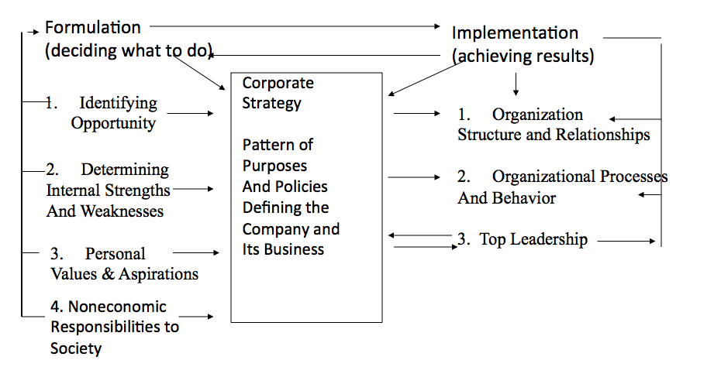
The Concept of Corporate Strategy
Course Framework Derived from Theory

Slide 13
Question 4: Does your syllabus build the appropriate skills/competencies?
Is the degree of difficulty right for the cohort?
Are assignments designed to force students to think? Or to show what they remember from prior readings and class sessions?
Do the assignments develop skills that build to a final exam or project?
For written assignments that take place during the course, how quickly can they be graded and feedback returned?
Do you want students to complete assignment prospectively for what will happen later in class, or retrospectively to reinforce what just occurred in class?

Slide 14
Expectations for Written Assignments
Homework assignments should be delivered electronically to the course drop box on or before the due date/time. All papers must be typewritten, double spaced, using Arial or Times New Roman font, font size 11.
Five page limit. Do not do additional research on the case, theories, or the topic generally; this is not a research project where more knowledge needs to be discovered. It is a chance to show how well you can apply key course concepts to a case situation as presented.

Slide 15
Sample Assignment: Forcing Evaluation and Judgment
Case: The Merger of UCSF Medical Center and Stanford Health Services
Using the five forces framework, what was the most threatening environmental force facing UCSF and Stanford Health Services in the mid-1990s? How well-positioned were the hospitals to deal with that force?
Using the McKinsey reading from Session 4 as a framework, what kind of value would you expect this merger to achieve and why?

Slide 16
Final Thoughts: What does your syllabus say about you and your course?
How would you characterize the tone?
Does your syllabus convey the excitement of what you teach?
What does it say about your organization and communication skills?
Are you willing to ask students for feedback on your syllabus?

Slide 17
An Introduction to Using Canvas

Slide 18
CEP Standard Template for Course Syllabi
https://www.hsph.harvard.edu/office-of-education/committee-on-educational-policy-cep/course-forms/
Course Management Forms

Slide 19
Linking a Syllabus in Canvas
Access Canvas from http://canvas.harvard.edu or https://my.harvard.edu
Provide an updated printable version of the syllabus at the Syllabus link in the navigation menu
The syllabus is an initial point of reference for learners as they enter the course
See a screencast demonstration of linking a syllabus file at this workshop’s Canvas site: CBTLI Workshops

Slide 20
Pre-course Canvas Tips
Organize and publish files
Edit page content
Discussions and Assignments
The Canvas Calendar
Notification Settings
Manage Course and People
Communication
Publish your site

Slide 21
Canvas Resources and Training
Click the Help in the bottom left corner of any Canvas page for 24x7 support by chat, e-mail, and phone
Email the Media and Educational Technology team at mets@hsph.harvard.edu with any questions or to set up a training or course consultation
Visit the Harvard Chan School’s Canvas page for the latest updates at http://hsph.me/canvas

